Slide 1

Mini Project Seminar
On
E-Gadget Hub

Slide 2

TEXTILE AND ENGINEERING INSTITUTE, ICHALKARANJI
(AN EMPOWERED AUTONOUMOUS INSTITUTE)
Internal Guide
Prof.Mrs.S.S.Tambire Mam
Name of Guide
Prof.Mrs.S.S.Tambire Mam
Assistant Professor
Department of Computer Science and Engineering
Sakshi Shivaji Kamble 23UCS051
Sakshi Sukhadev Kamble 23UCS052
Sonali Basppa Kotagond 23UCS066

Slide 3

E-Gadget Hub

Slide 4

Introduction
Electronics waste, commonly known as e-scrap or e waste, is the trash we generate from surplus, broken, and obsolete electronic devices. Electronics contains various toxic and hazardous chemicals and materials that are released into the environment if we do not dispose of them properly. E- waste or electronics recycling is the process of recovering materials form old devices to use in new products.
Electronic waste or E-waste is any broken or unwanted electrical or electronic appliance.
E-waste includes computers, consumer electronics, phones, medical equipment's, toys and other items that have been discarded by their original users.
E-waste also include waste which is generated during manufacturing or assembling of such equipment's.

Slide 5
Problem definition
To Design and develop a mobile application that enables users to locate e-waste collection centers, schedule pickups, and earn rewards for responsible disposal of electronic waste .

Slide 6
Aim and objective of the project
Aim : The aim is to reduce hazardous waste impact and improve recycling efficiency
Objective :
To develop a mobile app that helps users locate e-waste collection centers, schedule
pickups, and earn rewards for responsible disposal
Increase Awareness: Educate users about the environmental impact of e-waste and the importance of responsible disposal.
Encourage Responsible Disposal: Reward users for properly recycling their e-waste through a points or incentive system.
Promote Convenience: Allow users to easily locate e-waste collection centers and schedule pickups through the app.
Support E-Waste Regulations: Help users comply with local e-waste disposal laws and regulations.
Track and Report Impact: Enable users to track their recycling efforts and understand the environmental
benefits of their actions.

Slide 7

o Increase Awareness: Educate users about the environmental impact of e-waste and the importance of responsible disposal.
o Encourage Responsible Disposal: Reward users for properly recycling their e-waste through a points or incentive system.
o Promote Convenience: Allow users to easily locate e-waste collection centers and schedule pickups through the web application.
o Support E-Waste Regulations: Help users comply with local e-waste disposal laws and regulations.
o Track and Report Impact: Enable users to track their recycling efforts and understand the environmental benefits of their actions

Slide 8
Existing System
Manual Collection & Disposal
E-waste is usually collected informally by scrap dealers or local waste collectors.
Sorting is done manually, often without safety measures.
Unorganized Recycling Sector
A large portion of e-waste is handled by the informal sector using unsafe methods like burning, acid baths, and manual dismantling.
Leads to health risks and environmental pollution.
Lack of Tracking
No proper system to track how much e-waste is generated, collected, or recycled.
Proposed System
Digital E-Waste Management Platform
A centralized system to register e-waste generators (households, shops, companies) and recyclers.
Track e-waste from collection → transport → recycling.
Authorized Collection Centers
Set up official drop-off points where citizens can safely deposit old electronics.
Incentives for proper disposal (reward points, discounts, etc.).
Smart Scheduling & Pickup
Users can request door-to-door pickup of e-waste via a mobile app or website.
Automated route planning for collection vehicles.

Slide 9

Scope of the project -
User-Friendly Mobile Website: Design and develop an intuitive app interface compatible with Android and iOS platforms.
Locate Collection Centers: Users can view nearby authorized e-waste collection centers on an interactive map based on their location.
Pickup Scheduling: Users can schedule doorstep pickups for their e-waste, ensuring convenience and encouraging participation.
Reward System: Introduce a points-based or digital wallet system to reward users for each successful disposal.
Awareness Content: The app will include articles, tips, and notifications to educate users about the importance of e-waste recycling..

Slide 10
Requirement Specification
Functional Requirements:
User Registration and Login:
Secure sign-up and sign-in functionality using email and password.
Locate E-Waste Centers:
Display nearby recycling centers on a map using Google Maps API.
Pickup Scheduling:
Allow users to request doorstep pickup with date and time slots.
Reward System:
Allocate eco-points to users for each successful recycling activity.
Admin Dashboard:
Admins can manage centers, track pickups, and analyze user engagement.
Educational Content:
Articles, tips, and notifications related to e-waste management.
Device Evaluation:
Estimate resale/recycling value based on device condition and market value.
Non-Functional Requirements:
Platform Compatibility:
App must run on both Android and iOS platforms.
Performance:
App should respond to user actions within 2 seconds.
Scalability:
Must support expanding to more regions and users in the future.
Security:
User data must be protected with secure authentication and HTTPS protocols.
Availability:
Minimum 99% uptime for hosted services and backend systems.

Slide 11
Requirement Specification
Software Requirements
Programming Language: Java, HTML and CSS
Database: MySQL
Development Tools: Eclipse IDE
APIs: Google Maps API, Notification services
Processor: Intel i3 or higher
RAM: 8GB or higher
Storage: 100GB minimum
Active internet connection
Hardware Requirements

Slide 12
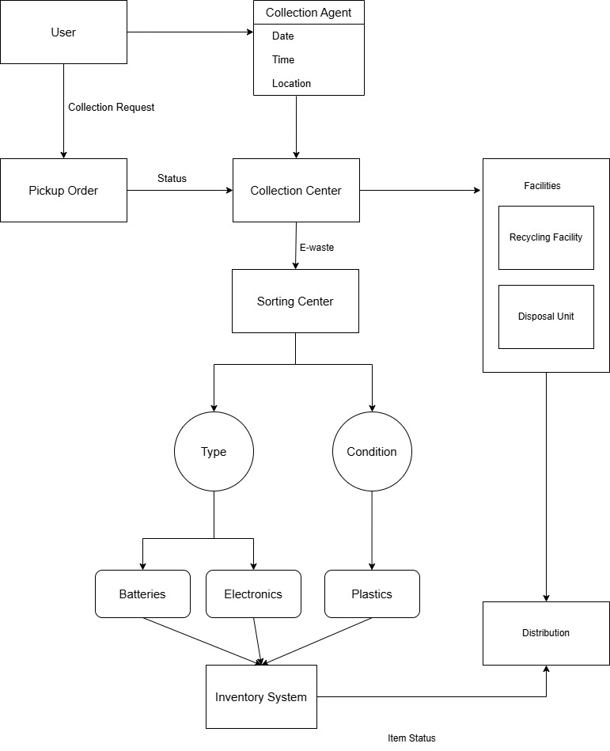
SYSTEM ARCHITECTURE

Slide 13
System Design
Algorithmic Description of Each Module
1.User Login Module
Algorithm:
Start
Prompt the user to enter username and password
Validate credentials against stored user data (e.g., in database or file)
If credentials are valid:
Grant access to the system
Redirect to the main menu/dashboard
Else:
Show an error message
Allow retry or exit option
End
2. Registration Module
Algorithm:
Start
Prompt user to enter required registration details (name, email, mobile, etc.)
Validate all input fields (e.g., check for empty, correct format)
If validation passes:
Store user details in the database
Generate and display a success message
Else:
Prompt the user to correct errors
End

Slide 14
System Design
Algorithmic Description of Each Module
3. Complaint Lodging Module
Algorithm:
Start
Display form for complaint entry
User selects complaint type, enters details
Validate complaint form inputs
If inputs are valid:
Save complaint to database with status “Pending”
Generate unique complaint ID
Notify user with confirmation
Else:
Show error and request correction
End
4. Admin Login and Complaint Management Module
Algorithm:
Start
Prompt admin for login credentials
Validate credentials
If valid:
Display dashboard with complaint records
Allow admin to view, update status (e.g., In Progress, Resolved), or delete complaints
Else:
Display access denied message
End
5. Report Generation Module
Algorithm:
Start
Admin selects report type (daily, weekly, monthly, status-based, etc.)
Fetch corresponding data from the database
Format data into readable report layout (e.g., table, chart)
Display or export the report as PDF/Excel
End

Slide 15
System Design
c) Algorithmic Description of Each Module
6. Collector Login Module
Algorithm:
Start
Prompt collector for login credentials (username and password)
Validate credentials against the database
If valid:
Display collector dashboard with assigned complaints/tasks
Allow collector to:
View complaint details
Update complaint status (e.g., In Progress, Resolved)
Else:
Display access denied message
End
7. Collector Registration Module
Algorithm:
Start
Admin navigates to "Collector Registration"
Admin enters new collector details (name, contact, ID, etc.)
Validate the entered details
If valid:
Store collector details in the database
Display success message
Else:
Display error message
End

Slide 16
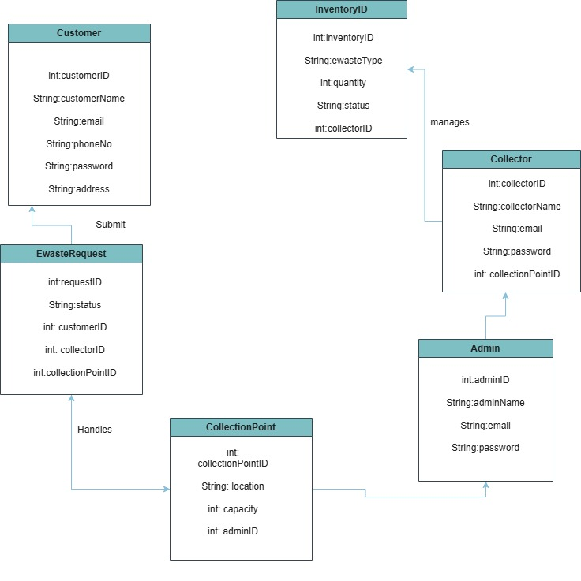
UML Diagrams
Class Diagram

Slide 17
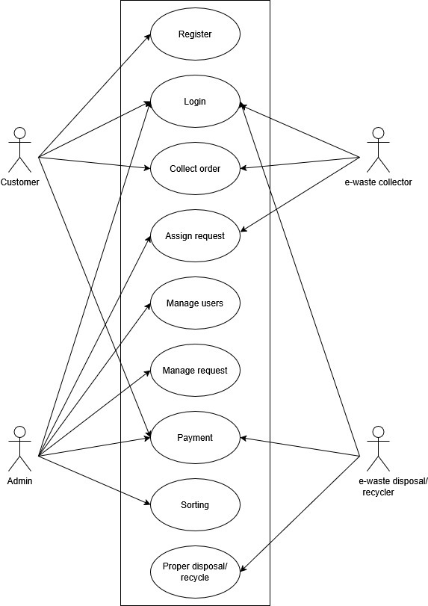
UML Diagrams
UseCase Diagram

Slide 18
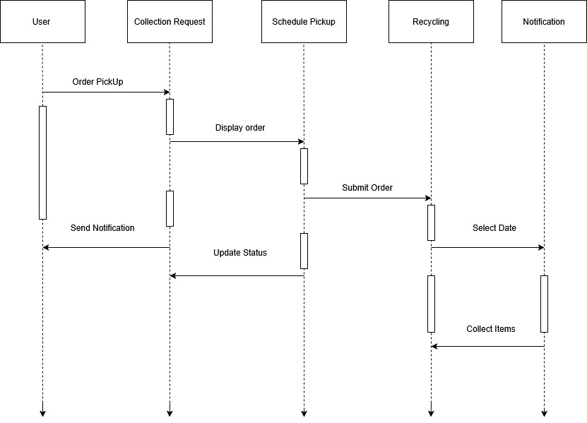
UML Diagrams
Sequence Diagram

Slide 19
Database Tables
Customer
CustomerID | CustomerName | Email | PhoneNo | Address | Password
C01 | Alice | a@mail.com | 9876543210 | Pune | pass123
C02 | Bob | b@mail.com | 9123456789 | Mumbai | pass456
Admin
AdminID | AdminName | Email | Password
A01 | John | john@admin.com | admin123
A02 | Riya | riya@admin.com | admin456
Collector
CollectorID | CollectorName | Email | Password | CollectionPointID
CL01 | Raj | raj@collector.com | col123 | CP01
CL02 | Meera | meera@collector.com | col456 | CP02

Slide 20
Database Tables
CollectionPoint
CollectionPointID | Location | Capacity | AdminID
CP01 | Pune-North | 200 | A01
CP02 | Mumbai-East | 150 | A02
EwasteRequest
RequestID | Status | CustomerID | CollectorID | CollectionPointID
R01 | Pending | C01 | CL01 | CP01
R02 | Approved | C02 | CL02 | CP02
Inventory
InventoryID | EwasteType | Quantity | Status | CollectorID
I01 | Laptop | 10 | Working | CL01
I02 | Mobile | 25 | Recyclable | CL02

Slide 21
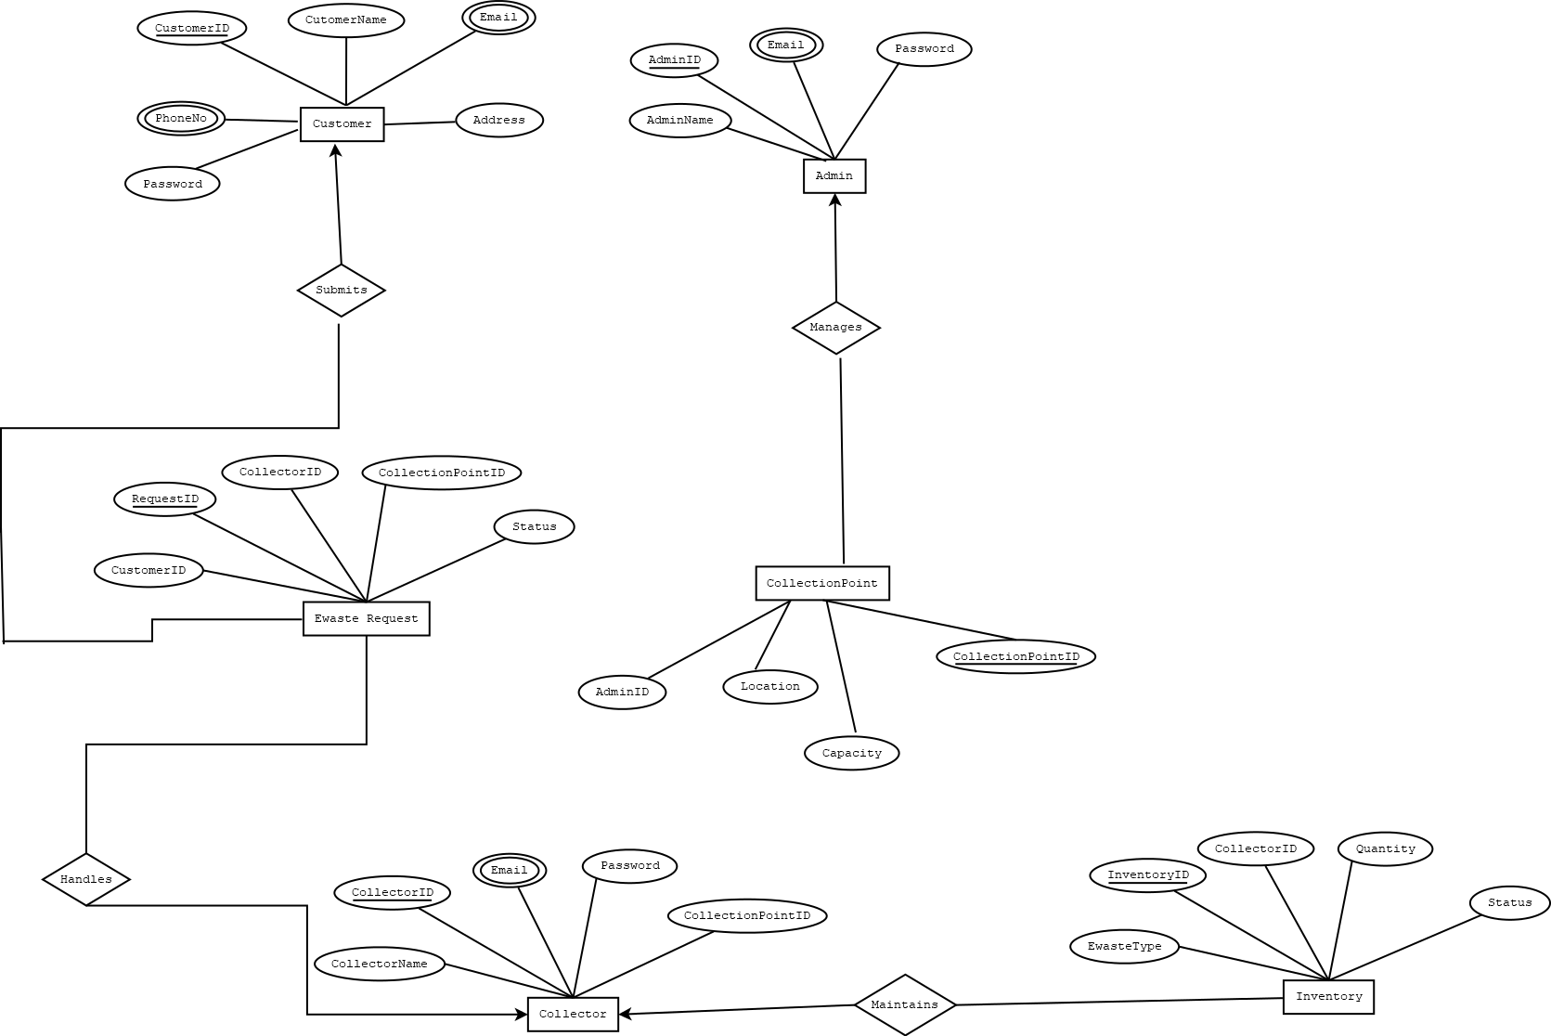
Entity relationship model

Slide 22

Technologies & platforms used
Frontend: HTML, CSS, JavaScript, JSP
Backend: Java (JDBC), Servlets
Database: MySQL
Tools: VS Code / Eclipse IDE
Platform: Windows/Linux, Chrome/Firefox browsers

Slide 23

Integration & testing
Test Case ID | Feature | Expected Result
TC_01 | User Registration | New user account created
TC_04 | Login | Invalid login shows error
TC_05 | Locate Centers | Centers displayed on map
TC_06 | Pickup Scheduling | Pickup added to database
TC_08 | Reward System | Points added after disposal
TC_10 | Admin Dashboard | Admin views all requests
TC_14 | Security | Encrypted password in DB

Slide 24
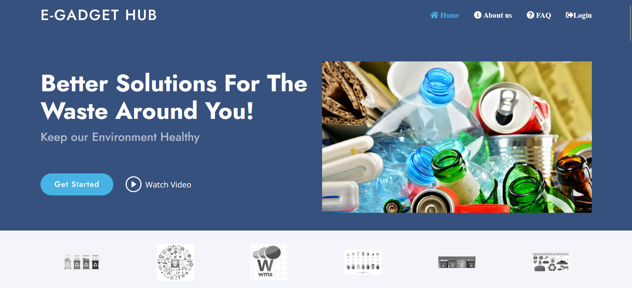
Output screen

Slide 25
Conclusion
A well-managed e-waste system ensures responsible disposal, minimizes environmental impact, and promotes recycling efficiency. The system streamlines collection, transportation, and processing to create a sustainable and eco-friendly waste management process.

Slide 26
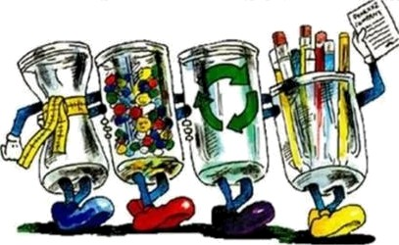
Conclusion
Reduce
Recover
Reuse
Recycle

Slide 27


